Slide 1
Home composting
Open the chat here now! Write questions here.
You are muted.
Composting Workshop Slides 12 June 2023
Notes:
Remove Zoom bar from slide if presenting face to face
Welcome to workshop
Housekeeping: You are muted. Open the chat. Any questions in the chat.
We’ll wait a few minutes for people to join us - In the chat, why did you come along to this session?
We’ll be recording so turn off camera if you don’t want to be in it
Start screen share
Start recording
Introduce self

Slide 2
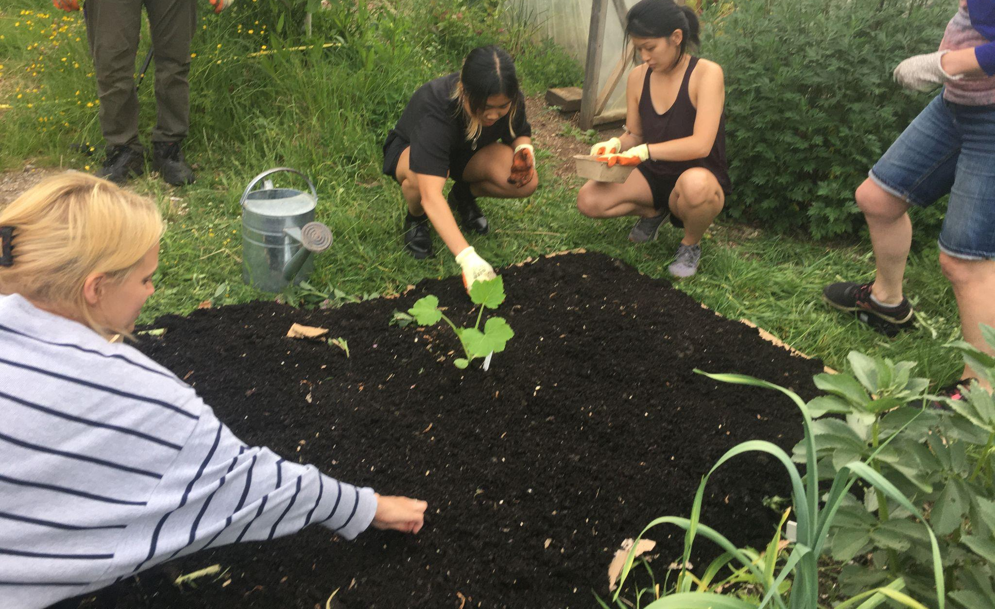
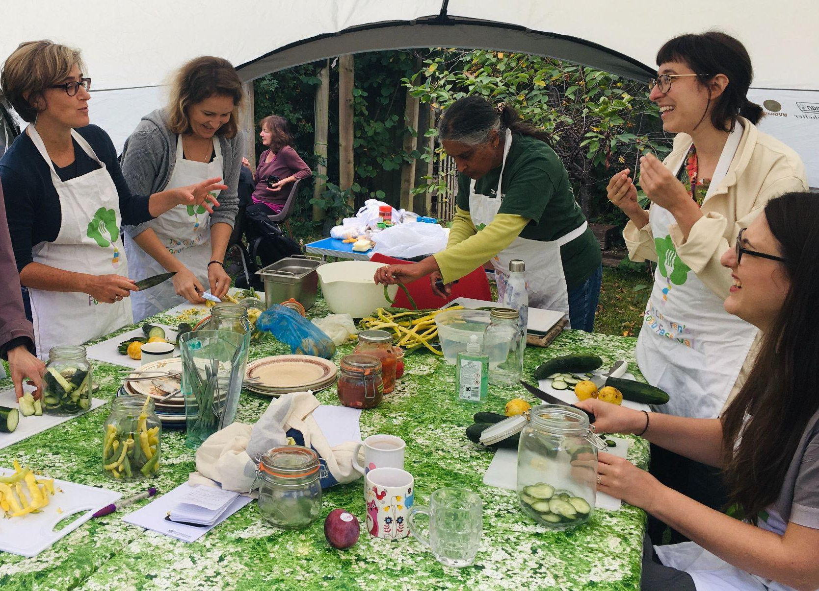
About Replenish
Supporting residents of Oxfordshire to grow and cook nutritious food with zero wastage. www.replenishoxfordshire.com
Composting Workshop Slides 12 June 2023
Notes:
Supported by oxfordshire county council

Slide 3
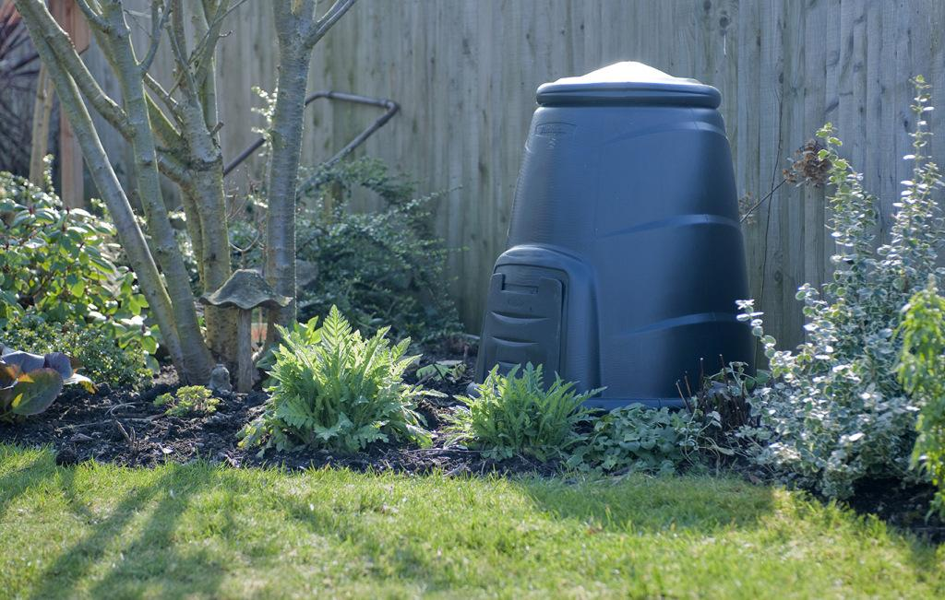
Overview of presentation
Benefits of composting
How composting works
Different composting methods/containers
Q&A
Composting Workshop Slides 12 June 2023
Notes:
Pass to liz

Slide 4
Take action! The food waste hierarchy
Reduce
Compost
Recycle
Composting Workshop Slides 12 June 2023
Notes:
The preferable option is to reduce food waste by minimising avoidable food waste and by re-distributing surplus food.
The next option is to compost, which is essentially a form of recycling food waste into a usable material.
The final option is to recycle i.e. via your council food waste collection.
In Oxfordshire this energy is recovered from food waste via anaerobic digestion, which also produces fertiliser for use on farmland.

Slide 5
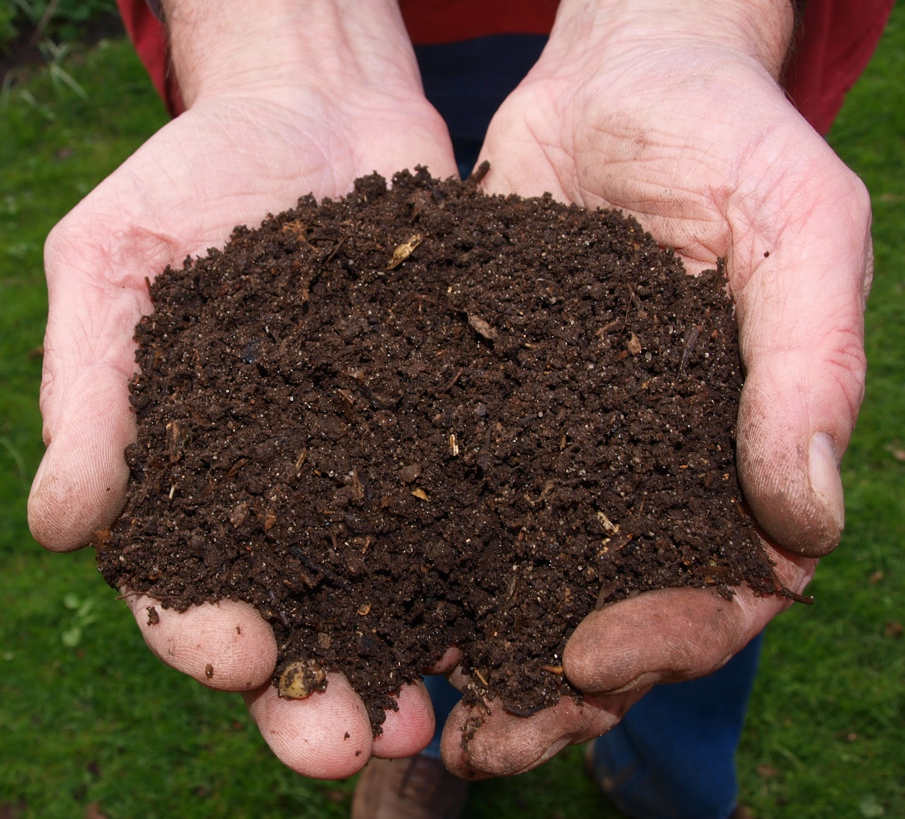
What is composting?
Digested by various living creatures e.g. bacteria, fungi, worms
Organic matter
End product: compost!
Composting Workshop Slides 12 June 2023
Notes:
In simple terms
Organic matter (is or used to be alive)- eaten/digested by living creatures for energy. In doing this they break down complex organisms (e.g. plants) into more basic elements - we call the product compost.

Slide 6
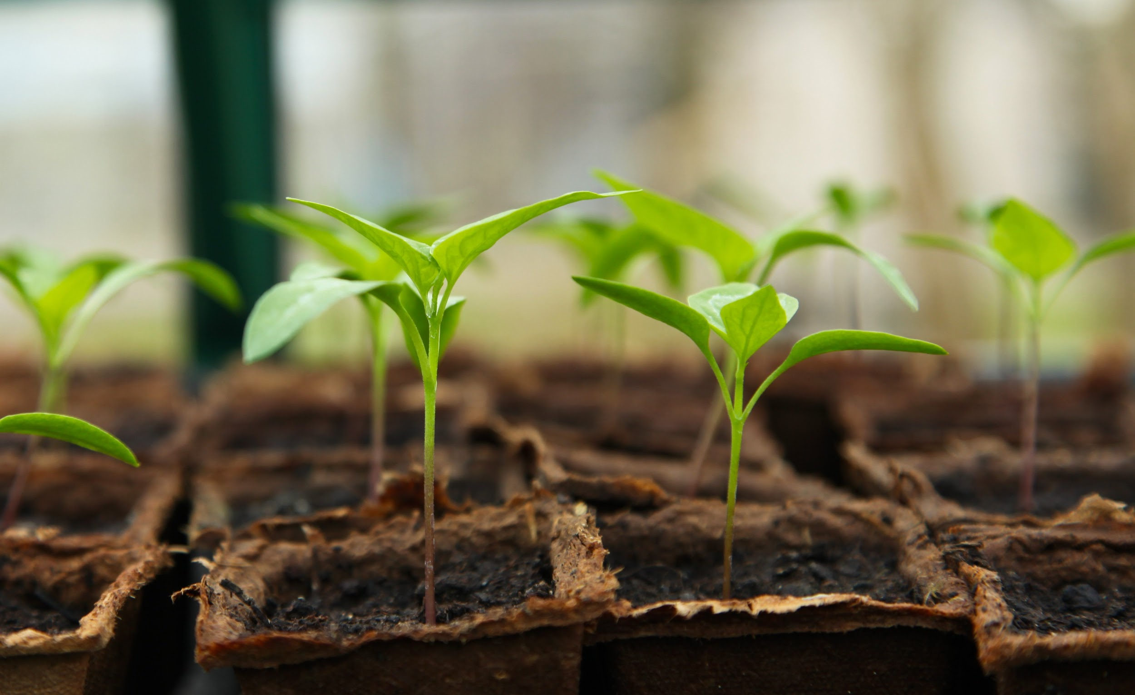
Benefits of composting
Saves money
‘Recycle’ kitchen and garden waste
Nutrients more available to plants
Improves soil structure
Contains beneficial organisms
Beneficial for the environment
Composting Workshop Slides 12 June 2023
Notes:
Saves money - shop bought compost is expensive
Transform kitchen and garden waste into valuable product
Nutrients have been broken down so they are more available to plants and other organisms that are part of the soil ecosystem. Food waste is high in nitrogen - an important nutrient for plants.
Improves soil structure, especially if heavy clay or very light sandy soil.
Contains beneficial organisms - these organisms are important for soil health
Look after your soil, your plants will normally look after themselves!
Beneficial for the environment - food waste in landfill produces methane (greenhouse gas, 25% more potent than CO2) and in an incinerator (as happens to general waste in oxfordshire) it slows down the process as it’s wet so doesn’t burn well.
Most food recycled in Oxfordshire goes into an Anaerobic Digester. The food breaks down and produces methane, which is captured and burnt to produce electricity. The remaining liquid material (digestate) can be used as a fertiliser. Collecting and transporting the material has a carbon footprint, so composting at home is preferable.

Slide 7
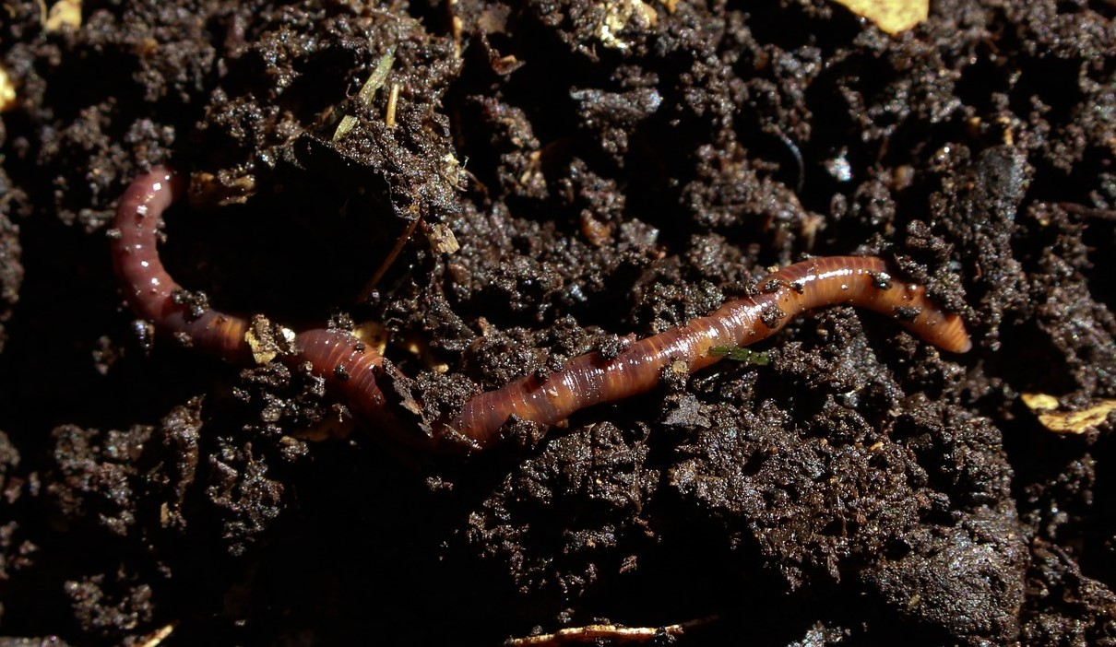
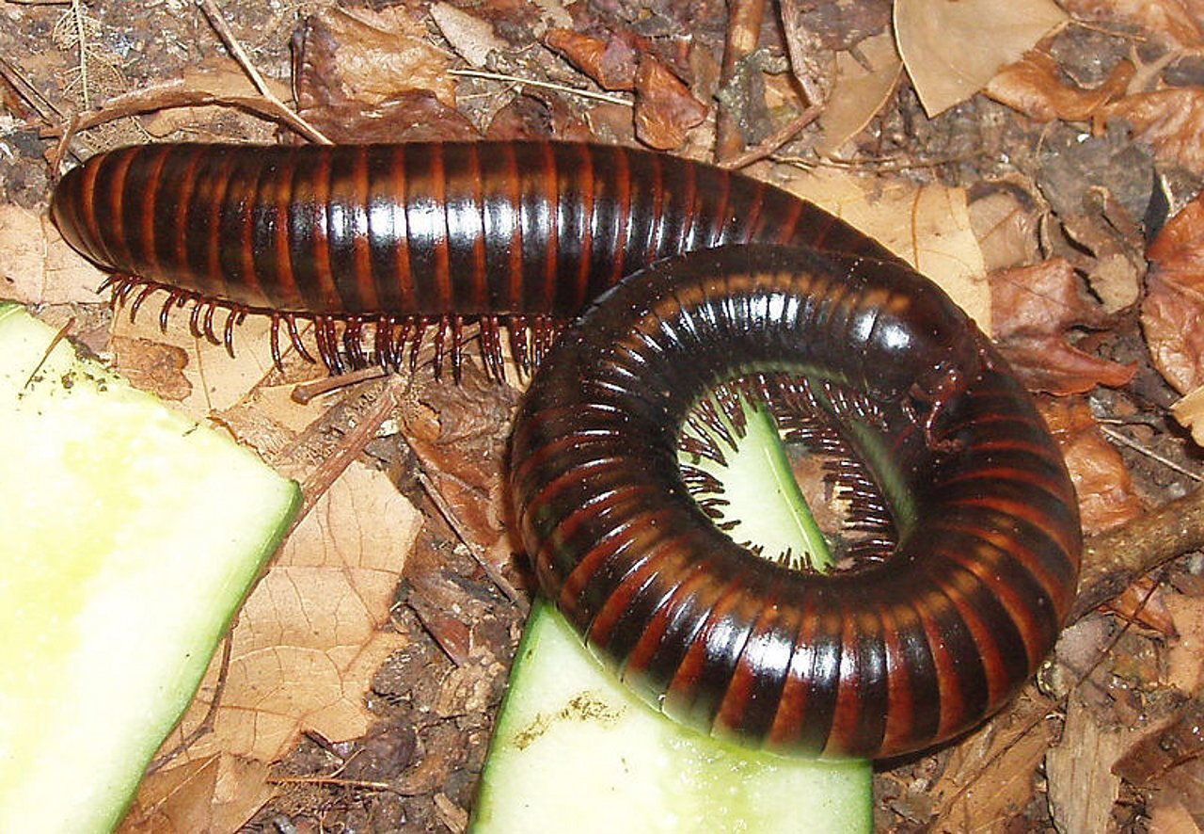
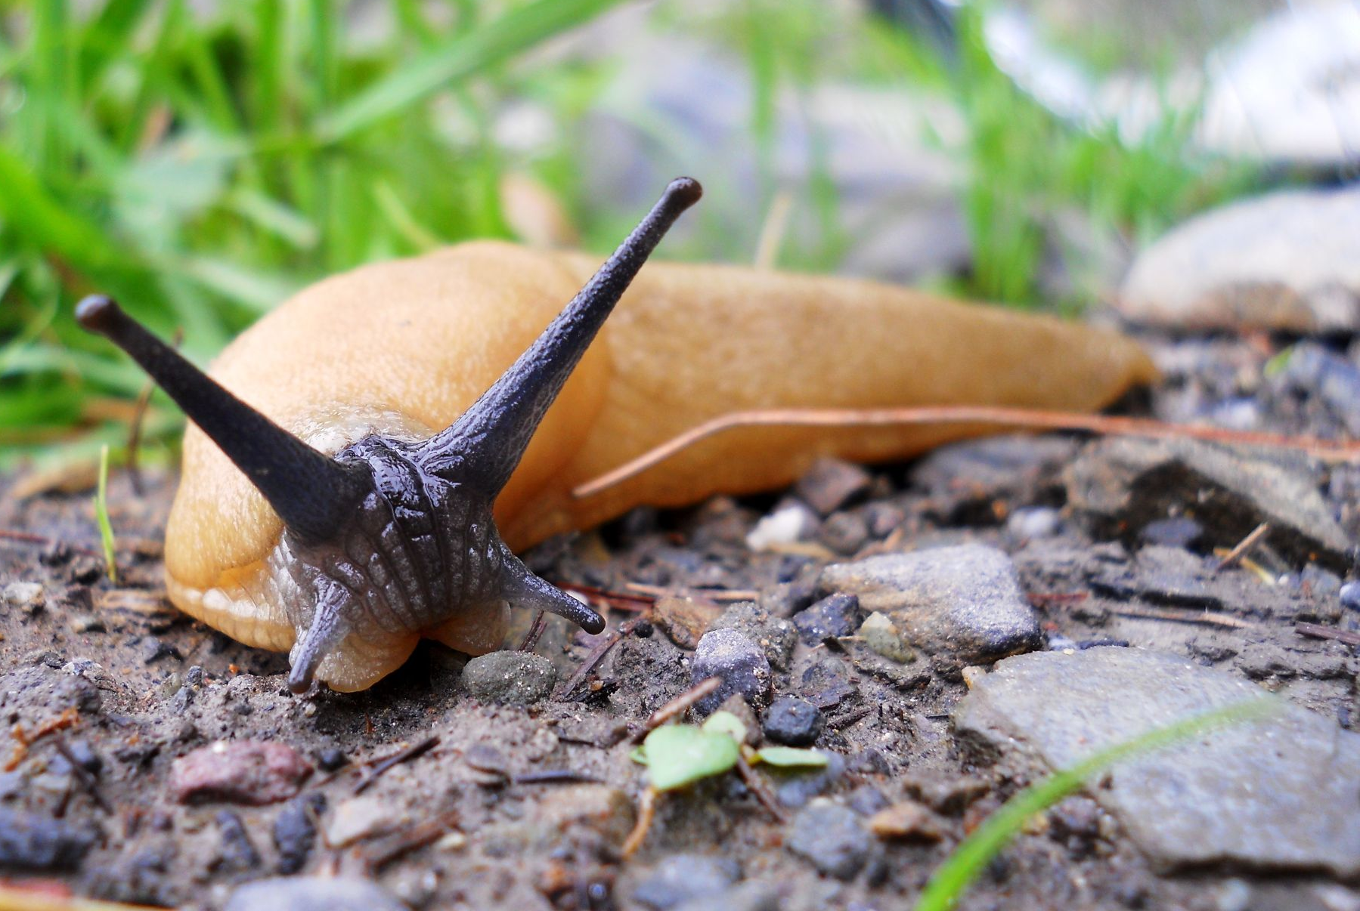
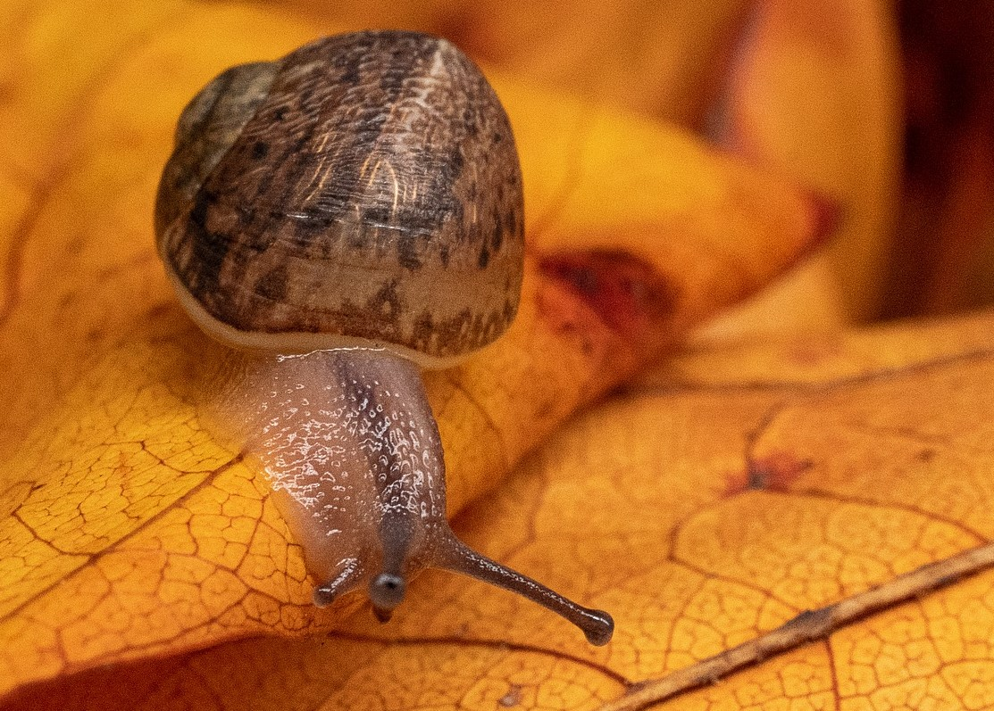
The creatures in the compost pile...
Microorganisms, such as bacteria and fungi
Macroorganisms, such as worms, millipedes, slugs and snails
Composting Workshop Slides 12 June 2023
Notes:
There are thousands but lots of microorganisms (i.e. small) bacteria, fungi, and macroorganisms (big) worms, millipedes, ants, woodlice, slugs and snails
Diversity leads to resilience: a good compost pile requires many different types of organisms that are suited to different environments. Why? Prompt: if the conditions change over time, for example, it gets very cold, it gets wet, dry etc. why would it be good to have lots of different kinds of microorganisms?

Slide 8
Aerobic versus anaerobic composting
Aerobic composting - organic matter is broken down by aerobic organisms
Anaerobic composting - organic matter is broken down by anaerobic organisms
Benefits of aerobic composting:
Faster
Hotter
Produces CO2 not methane
Not smelly
Composting Workshop Slides 12 June 2023
Notes:
Aerobic composting - organic matter is broken down by aerobic organisms - they require oxygen to survive
Anaerobic composting - organic matter is broken down by anaerobic organisms - don’t require oxygen
Benefits of aerobic composting:
Faster process
Hotter: bacterial activity produces heat - can kill diseases and weed seeds
Produces CO2 not methane - better for the environment
Not smelly
Make sure there is enough oxygen in the compost pile

Slide 9
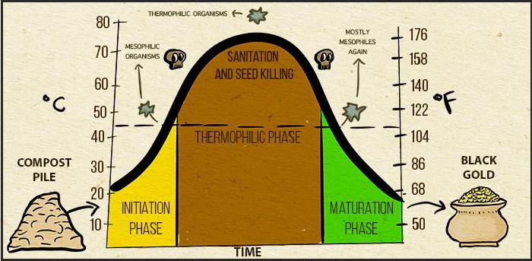
3 stages of aerobic composting
Image by Kirstynn Joseph from Untamed Science
Composting Workshop Slides 12 June 2023
Notes:
Mesophilic stage: This stage is dominated by mesophilic microorganisms. The compost heap starts to warm up as these organisms increase in number and give off heat. This stage lasts 5-10 days
Thermophilic stage: As the heat increases, heat-loving thermophilic microorganisms take over, creating an even hotter pile. Most of the plant materials are broken down during this stage. Stage 2 can last weeks or months, depending on the other conditions.In order to kill pathogens and weed seed the temperature needs to reach 65-70 ºC. In the UK, this can be difficult to achieve without using a hot composter.
Maturing stage: As thermophilic microorganisms use up easily available proteins, fats, and complex carbohydrates, the compost enters the maturing stage and the mesophiles take over again. Tougher material is broken down, with more work done by large creatures like worms, millipedes, ants, woodlice, slugs and snails.

Slide 10
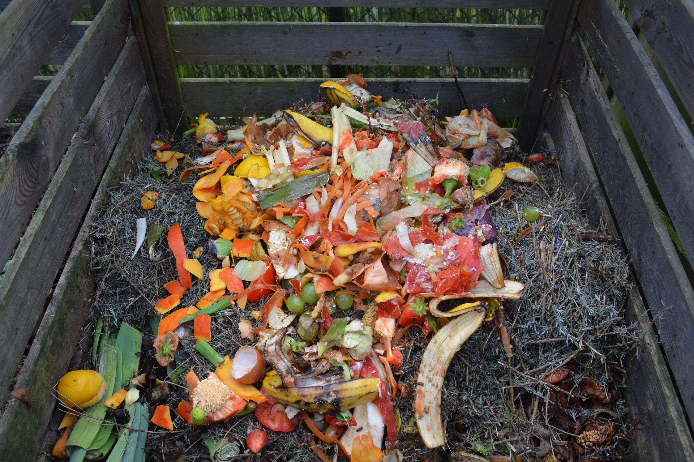
Position and size
Directly on ground
Sheltered location
Away from fence/shed
Away from trees
Accessible
1 metre cubed
Composting Workshop Slides 12 June 2023
Notes:
Directly on ground: allows worms and organisms access and rain water to run off.
Can situate on concrete, but less ideal.
Sheltered location: prevents overheating and drying out from the sun or wind or getting very wet from rain. Part sun will help it heat up.
Near a water source: compost heaps need to be kept moist, so you might want to position it near a waterbutt/tap or make sure your hose pipe reaches it.
Away from fences/sheds: heat can pose a slight fire risk, although unlikely in UK - keep moist to avoid this.
Away from trees: you don’t want roots from trees or large shrubs to grow under or in your compost bin or for them to take all the moisture.
Accessible: choose a convenient location for adding new materials and to use the finished product, allowing access with a wheelbarrow/near garden beds Passing or visiting the site regularly reduces the chance of rodents nesting, especially if you make noise. You might not want it too near the house though in case of smells or rodents
3-5 feet or 1-1.5 metres cubed will retain moisture and be large enough to heat up sufficiently. Generally the larger the better depending on the space you have available. Bigger bins will get hotter and compost faster, especially important in cooler climates.

Slide 11
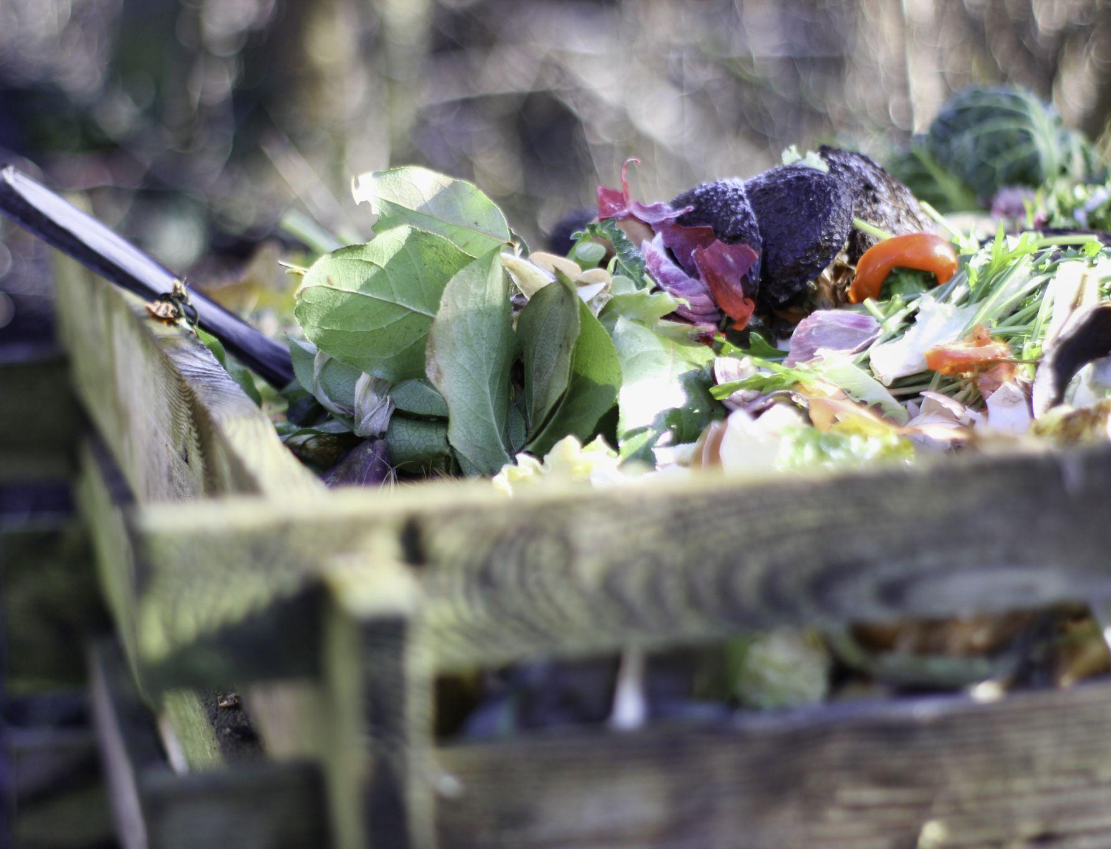
A place to call home
Mix of organic materials
Size of materials
Warmth
Oxygen
Water
Composting Workshop Slides 12 June 2023
Notes:
How can we create an attractive place for a diverse range of organisms to survive and thrive in the compost pile?
A mix of organic material;
We talked about wanting a diverse range of organisms
To have this you need a diverse range of materials in the pile, as this supports the diet of different organisms
We’ll cover what those are in a minute
Also: add in a spade of compost from an existing bin/heap to introduce microbes, and a handful of soil from the ‘forest floor’ to bring in fungi
Material of the right size: smaller materials - more surface area - easier for for organisms to access - faster decomposition. Particularly important for tougher materials that are more difficult to break down - woody materials. Chop kitchen scraps, shred or mow garden waste, tear up cardboard and shred paper
Warmth: important for heat-loving bacteria
Oxygen - as discussed Aerobic bacteria require oxygen to survive
How would you bring oxygen into pile?
Materials with air pockets
Make chimneys in the pile by poking holes with a big stick
Turning the pile regularly with a garden fork or aerator to mix materials throughout the pile
The right amount of water… moving on to next point
Water - the creatures in your compost need this to survive, but if there’s too much water, there isn’t space for air and it’s difficult for the creatures to access oxygen.The composting process will slow, and anaerobic composting may take place
Moist but not wet. How might you know if too dry/wet? Squeeze a handful - 2-3 drops water only.
Signs it’s too dry - looks dry and things aren’t breaking down quickly. there are ants - these are also a sign there are too any woody materials (more on this later)
Signs it’s too wet, it’s smelly and things are not breaking down quickly.
Monitor and adjust.
How would you control water levels?
Watering pile
Covering pile
Mix material throughout the pile
Add more greens if dry, browns if wet

Slide 12
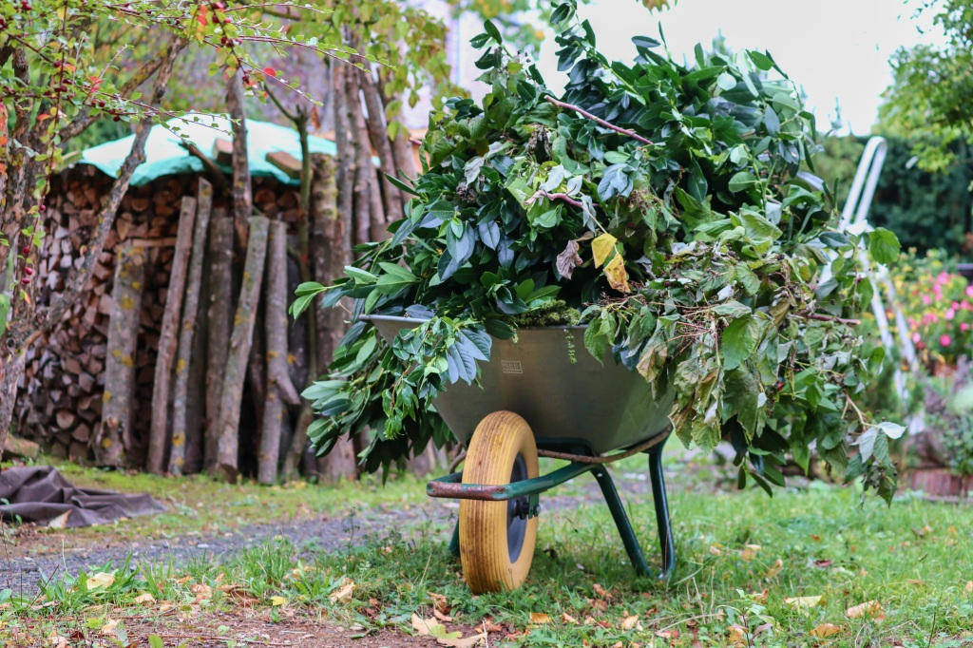
What can you compost? Examples:
Coffee grounds
Tea leaves / bags
Grass clippings
Garden waste
Fruit and veg scraps
Hay*
Manure*
Wood ash
Shredded cardboard
Leaves
Shredded paper
Newspaper
Wood chips
Straw
Wool/cotton
Egg shells
Composting Workshop Slides 12 June 2023
Notes:
Lots! It depends on the system you use but for example...
Any organic material can be composted.
Including cardboard and paper/newspaper in compost reduces the need for recycling
Also pine needles, nut shells, napkins/paper towels (unbleached or dyed), coffee filters, stale bread, cooked plain rice/pasta
Ensure tea bags are plastic free
*Avoid hay that contains a lot of seeds or that is non-organic as it can contain aminopyralid, a type of weed killer that is toxic and severely affects the growth of plants like tomatoes and potatoes. Aminopyralid can also be in manure of cattle and horses fed on non-organic hay. It is not currently approved for use on straw.

Slide 13
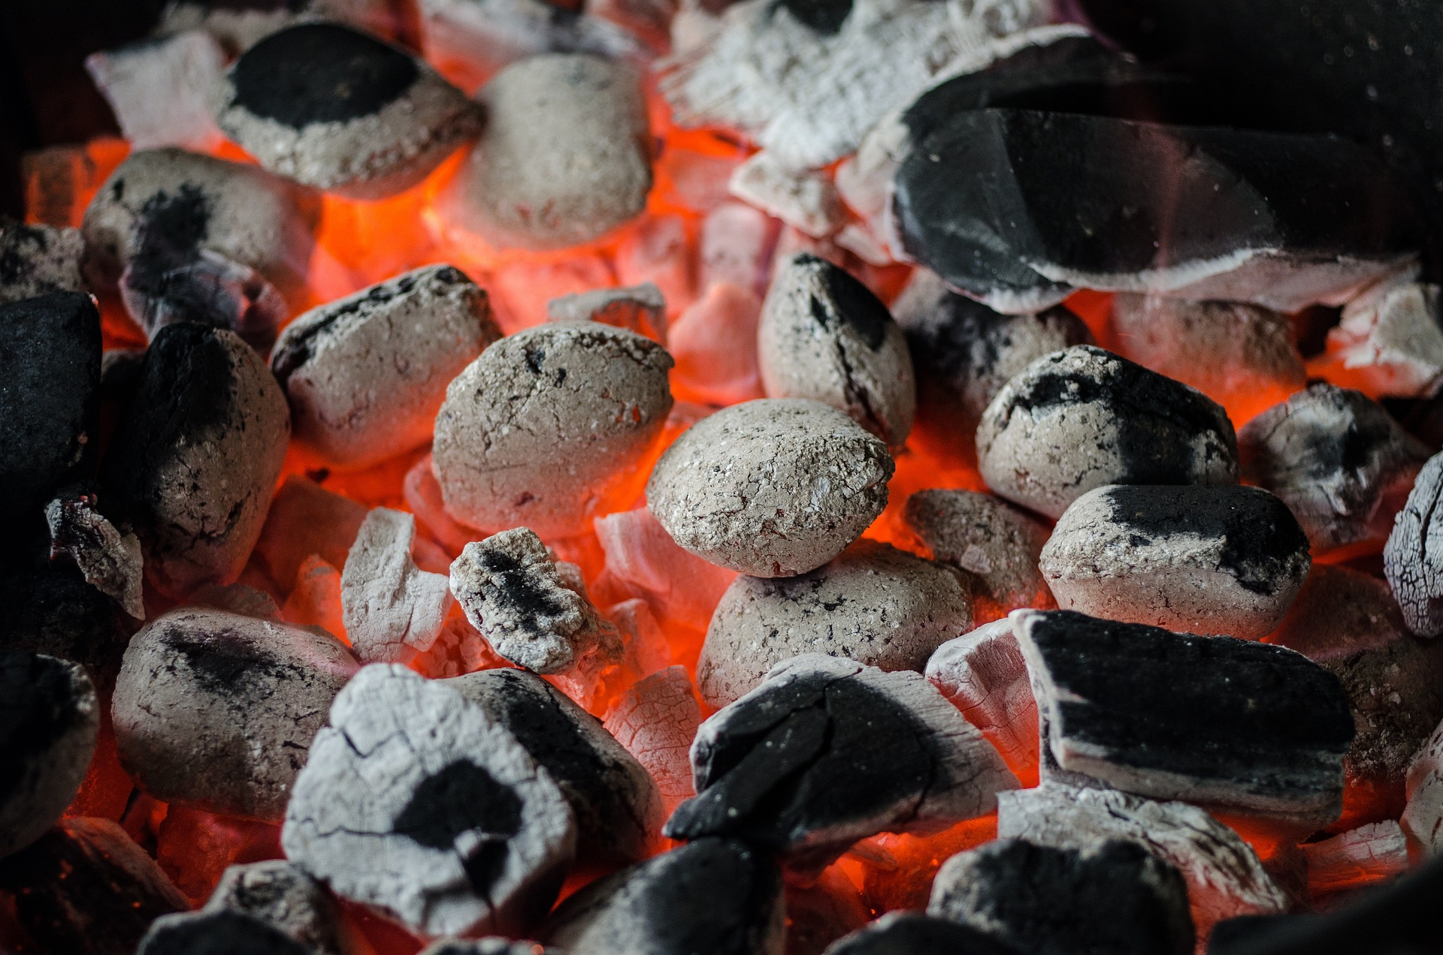
What can’t you compost?
Non-organic materials - e.g., plastic, metal, glass
Meat/fish/dairy products (OK in some systems)
Cooked food (OK in some systems)
Fats and oils
Dog poo and cat litter
Perennial weed roots/weed seeds
Diseased plant material
Charcoal / coal ash
Composting Workshop Slides 12 June 2023
Notes:
Temperature not usually high enough to kill weed seeds or pathogens in meat/fish/dairy, dog/cat poo or diseased plant material.
Cooked food/meat/fish and dairy may also attract rodents, but can be composted in certain systems - see later.

Slide 14
Carbon to nitrogen ratio (C:N) of materials
Carbon and nitrogen needed to support microorganism activity
Need balance between materials high in carbon (aka browns) and materials high in nitrogen (aka greens)
Line the bottom with woody brown material
Add material gradually in alternate layers of brown and green
Don’t have enough greens or browns? Join Sharewaste
Composting Workshop Slides 12 June 2023
Notes:
Materials: carbon:nitrogen ratio
Carbon and nitrogen are 2 key elements that your microorganisms need to survive - they provide (amongst other things) them with energy and proteins
Some materials v high in carbon, others high in nitrogen
So you need a balance of materials containing lots of carbon, and materials containing lots of nitrogen - to make sure the microorganisms have what they need.
Aim for a roughly 50:50 mix and if in doubt add slightly more browns.
Gradually add premixed materials in 30 cm layers or add alternate layers of green and brown material around 10-15 cm deep every 7-10 days
Grass clippings are high in nitrogen and adding too many at once can be problematic - mix with autumn leaves or other brown material or a few spades of soil if short of brown material.
If you have too much or too little of one this can be a problem - Sharewaste connects people who have waste to dispose of with those who need it.

Slide 15
High carbon materials (aka ‘browns’) | C:N
Wood chips | 400:1
Shredded cardboard | 350:1
Shredded paper | 175:1
Straw | 75:1
High nitrogen materials (aka ‘greens’) | C:N
Vegetable scraps | 25:1
Coffee grounds | 20:1
Grass clippings | 20:1
Manure | 15:1
Vetch (similar for other legumes) | 11:1
Aim for roughly 50:50 mix of high carbon and high nitrogen materials
Composting Workshop Slides 12 June 2023
Notes:
Talk through table
You’ll notice that all materials are higher in carbon but for some the difference is very big
Materials high in ‘carbon’ often called browns and those high in nitrogen often called ‘greens’ - but this can be confusing because browns are not always brown in colour, and greens are not always green!
Aim for roughly 50% high carbon and 50% high nitrogen
Adding 10% very high nitrogen materials (like legumes, coffee grounds or urine) can help feed bacteria and get the party started.

Slide 16
Getting the mix right - spot the signs
Too much high nitrogen matter:
Smelly
Wet and slow to break down
Mix in bulky, high carbon materials like wood chip/scrunched up newspaper/torn up cardboard and /or poke holes or turn to add air
Too much high carbon matter:
Dry pile and slow to break down
Ants in the pile
Mix in high nitrogen materials and/or add water
Composting Workshop Slides 12 June 2023
Notes:
Can be hard to know exactly how much of each material to put in, as all have different C:N but you can observe your compost and notice the signs...
Signs of too much high nitrogen matter:
Smelly : excess nitrogen means pile can release ammonia which smells bad or there may not be enough oxygen and so pile is anaerobic and producing methane.
Slow to break down and wet: high nitrogen materials normally have more water content - doesn’t leave much space for air and aerobic organisms required for composting can not survive.
Fix by mixing in bulky carbonaceous materials like woodchips or scrunched up newspaper or torn cardboard to add air pockets. Use a stick or compost aerator to poke holes or turn to add more air.
Signs of too much high carbon matter:
Slow to break down, dry - bacteria are key players in breaking down organic matter. They need enough nitrogen to survive so without this you cant support large populations of bacteria and the process will be slow
Fix by mixing in high nitrogen ingredients - sometimes also adding some water
Layers: Add high nitrogen and high carbon ingredients in layers so that ingredients are mixed throughout
Often, especially if you’re composting food waste, your problem will be too much nitrogen as opposed to not enough

Slide 17
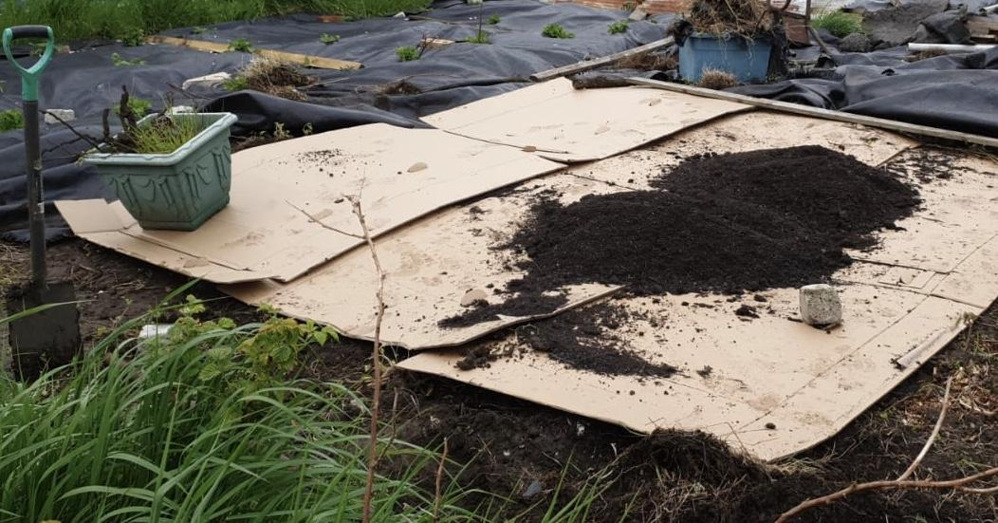
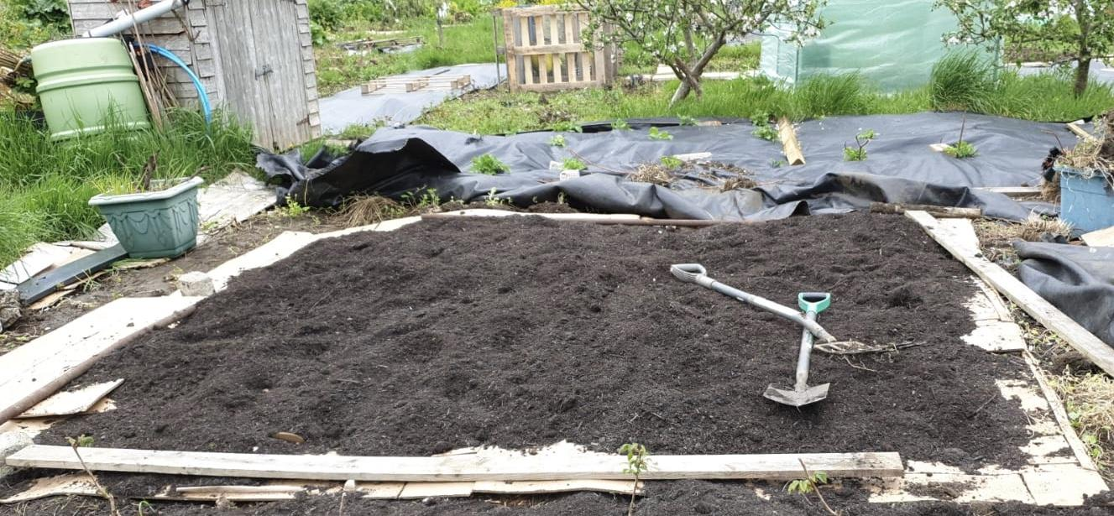
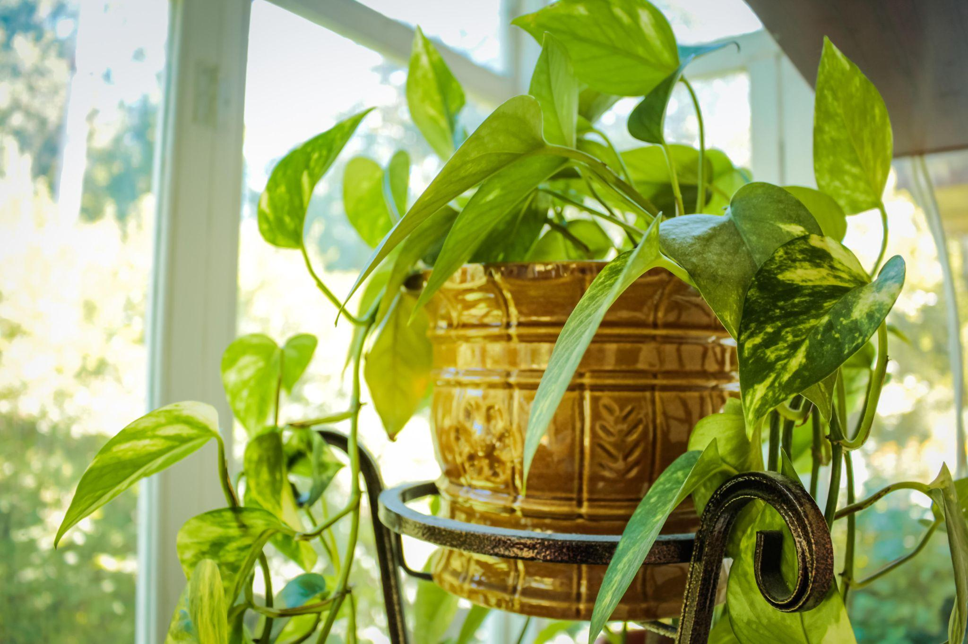
Using compost
Finished compost will be dark brown-black, crumbly and smell earthy.
As a mulch
Add to pots
Feed your lawn
Make compost tea
Composting Workshop Slides 12 June 2023
Notes:
The finished product will be dark brown-black and will look like soil.
It may still contain lumps of wood material, but can be sieved for use in pots.
Mulch: use it as a mulch by spreading 5-10 cm thick over garden beds and around trees/shrubs - do not allow to touch soft stems or trunks as this may cause rotting.
Mulch after rain in early spring or autumn to retain moisture and suppress weeds.
In pots: garden compost alone is too strong for starting seeds or young plants.
Can be mixed with soil or leaf mold to create a potting mix - lots of recipes online - generally add ⅓ compost.
Lawn feed: mix with sharp sand and spread a 2.5cm thick layer over the lawn and rake in.
Compost tea: add a shovel of compost to a 5 gallon bucket of water (dechlorinated or rain water), mix with a stick and leave for 2-5 days in the shade. Stir once or twice per day to add oxygen. Strain and use as a liquid plant feed or spray on foliage (dilute if dark brown or black, 1 part to 3 parts water). Return the solid compost to the heap.

Slide 18
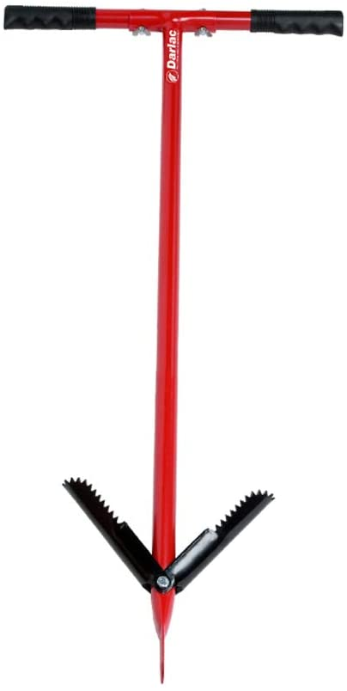
Composting garden waste:
Dalek bins
Costs £25
Takes 6-12 months
Garden waste
To avoid rats, only add food waste if bottom is sealed
Turn monthly with compost aerator
Compost aerators (~£30)
Metal ones (on the right) are much more durable.
Composting Workshop Slides 12 June 2023
Notes:
Go through slide
Use concrete paving slab and wire mesh to prevent rodent access
The downside of dalek bins is that they are awkward to get into and turn. If you do use one, you could drill holes in it to increase air flow, but this will also cool it down.

Slide 19
Composting garden waste:
Pallet bays
Easy and cheap to make
Avoid food waste, perennial weeds, weed seeds and diseased material
Best way is a 3-bay system: Fresh materials go into bin 1, semi-decomposed compost turned into bin 2, finally waste turned into bin 3 to mature and cool
Composting Workshop Slides 12 June 2023
Notes:
Pallet bins are quick to make and you can often get free pallets from industrial areas, supermarkets and department stores, construction sites, wholesalers and small businesses.
If using 1 bay, turn regularly with garden fork
Creates a problem of where to add fresh waste - if you keep adding to semi finished compost you’ll never have finished compost
3 bin system is best. Fresh materials go into bin 1, semi-decomposed compost turned into bin 2, finally waste turned into bin 3 to mature and cool

Slide 20
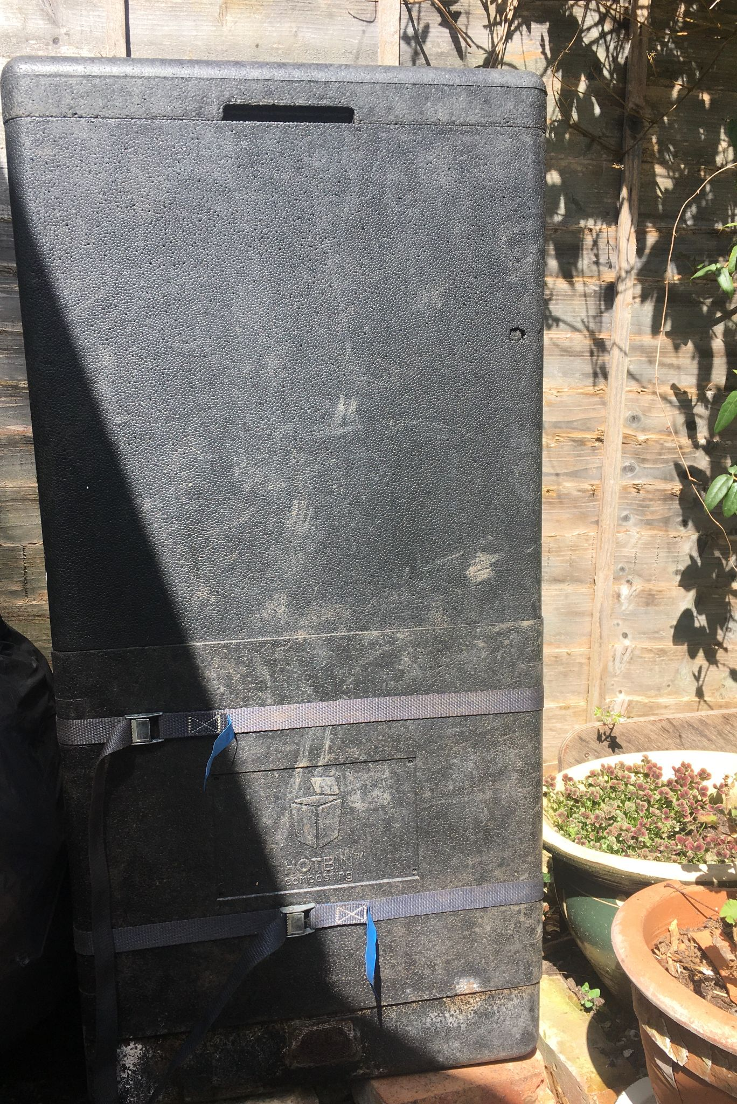
Composting food waste:
Hot bins
Costs from £140
Hot composting 40-60 °C in an Insulated bin
Heat kills weed seeds and pathogens in meat/fish
Mostly for food waste, could add some garden waste
Rat-proof, in theory
Faster composting process - approx. 3 months
Composting Workshop Slides 12 June 2023
Notes:
Costs upwards of £140
Hot composting done in an insulated bin. The contents can get quite hot (up to 60 °C) which will kill weed seeds and pathogens. Safe to compost cooked food, dairy, meat and diseased plants.
Supposedly rat-proof
Faster process - finished compost in about 3 months.

Slide 21
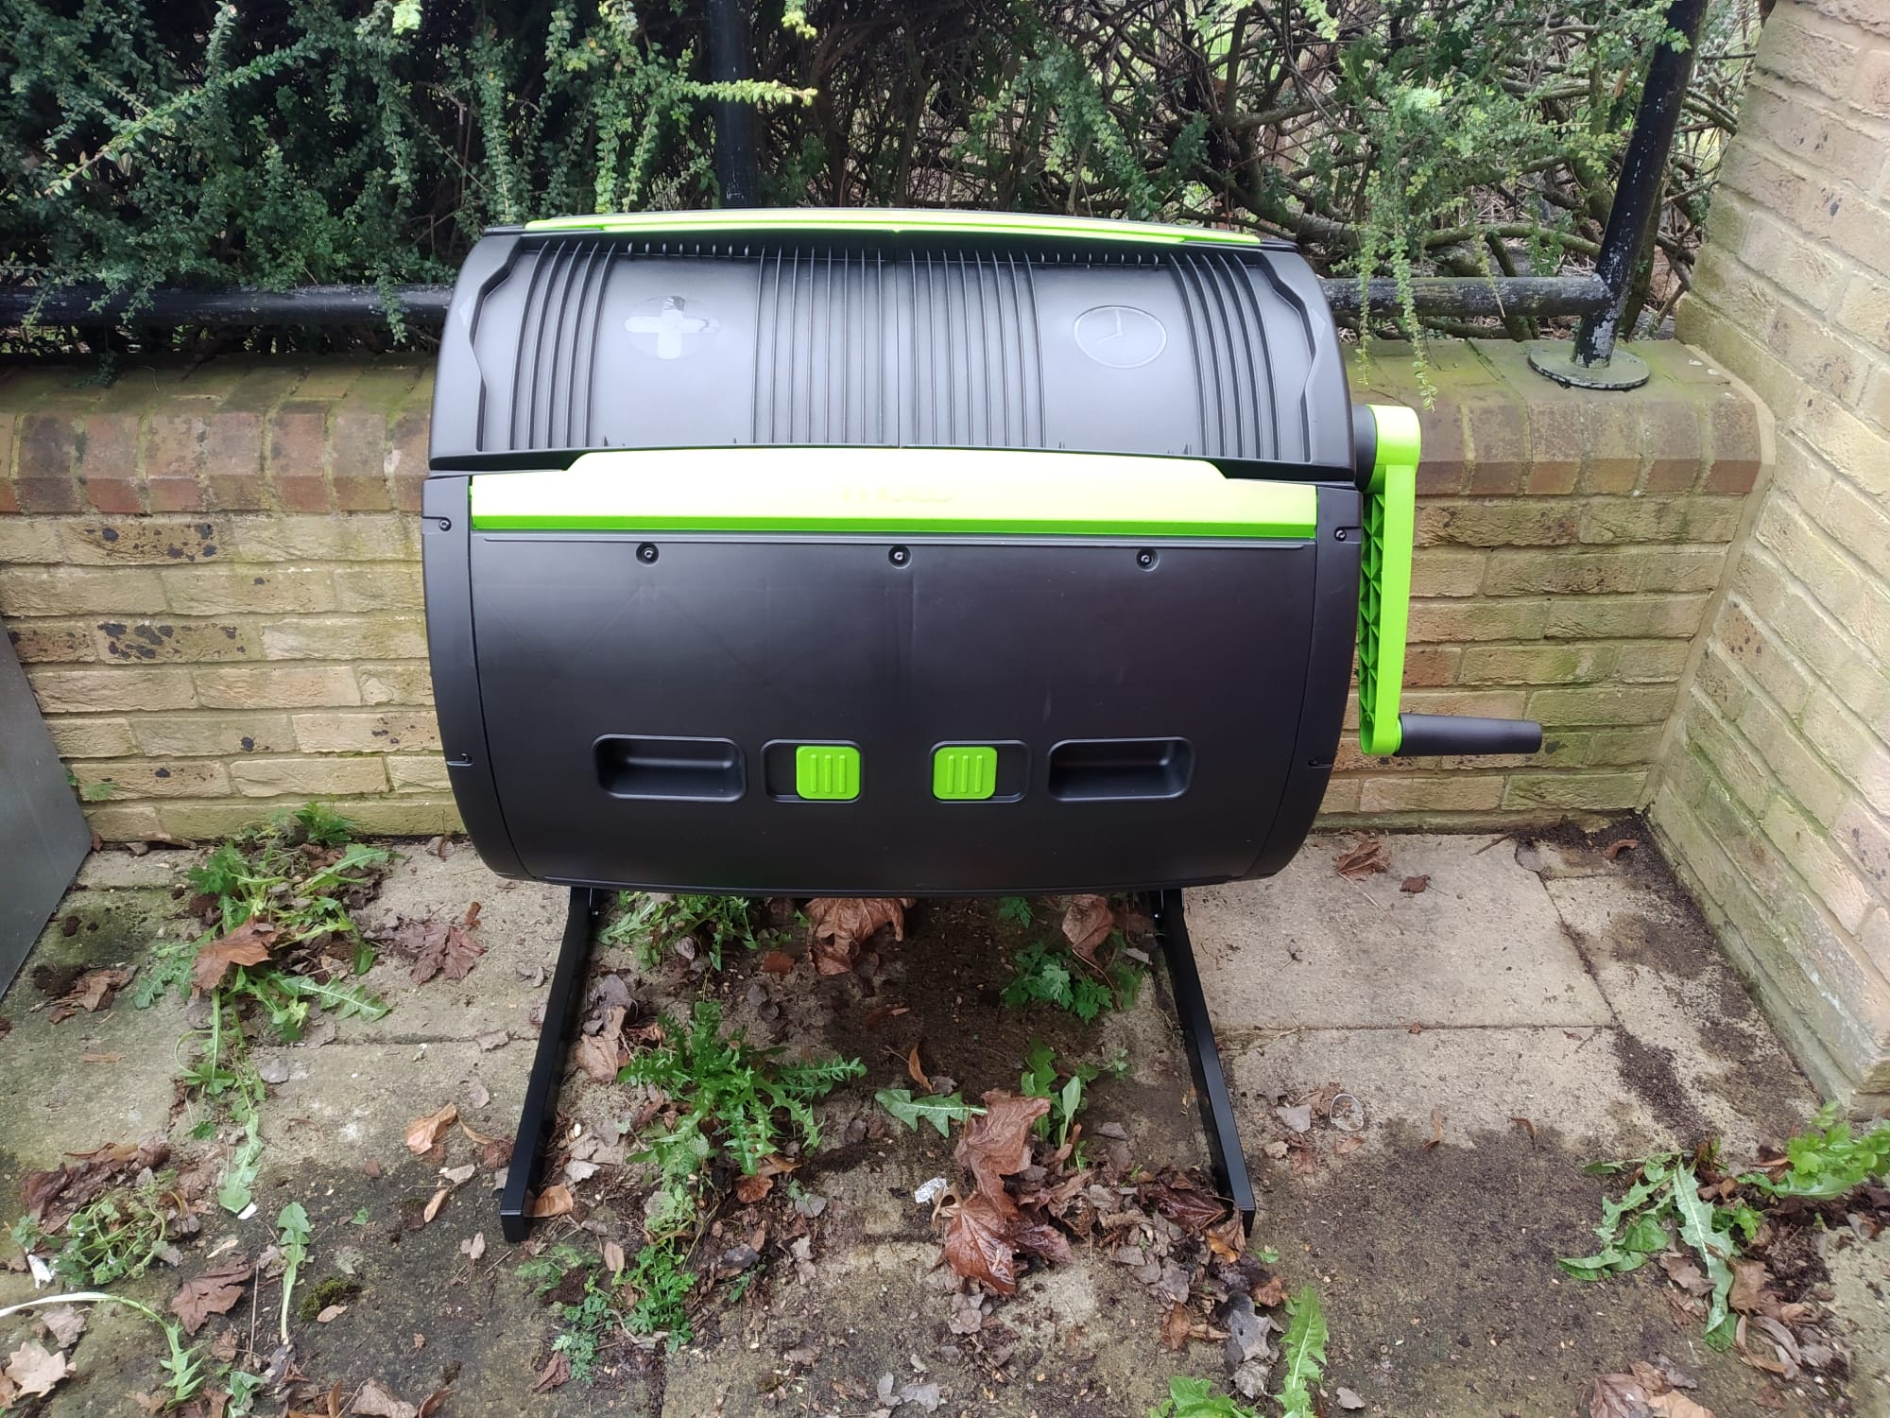
Composting food waste:
Tumblers
Costs from £50
50% food waste or grass clippings, 50% carbon (woodchip)
Easy to turn with handle
Within a few weeks the contents should be unrecognisable as food.
Transfer to pallet bin or heap. Bacteria and worms etc. finish breaking it down.
Rats not interested at this point
Can become heavy and more difficult to turn
Composting Workshop Slides 12 June 2023
Notes:
While an expensive option (maze tumblers cost around £190), tumblers are an excellent way of quickly composting food waste
Good for batch composting, rather than continuously adding material.
Tumblers do not contain worms - don’t add them as compost can get too hot for them. Bacteria and fungi decompose the organic matter.
Alongside your food waste, you should add high carbon materials (roughly equal amounts). Best if filled rapidly or you have to wait longer for final product.
We recommend wood chip, as it creates air pockets which prevent your compost from going anaerobic. Otherwise you could use shredded paper.
Also good for grass clippings (as lots of air incorporated to prevent it becoming anaerobic) alongside brown material.
Tumblers have a handle which allows you to 'turn' the compost to introduce air without much effort. Turn it once a day or as per the instructions
Can collect the liquid from drainage holes. Within 2-3 weeks the contents should be unrecognisable.
At this point it is ready to go into a pallet bin or heap where it should 'mature' and cool for several weeks before being used.
While rats can be attracted to food waste, rats will not be attracted to the matter removed from the tumbler.
Possible downside: can become heavy and difficult to turn

Slide 22
Composting food waste:
We recommend using a sealed container as food waste can attract rats.
Wormeries/vermicomposting
For small amounts of food waste
Great as educational tool for kids!
Produces two products: leachate/liquid (fertiliser) & high quality compost
No need to turn it - worms do this!
Costs £60+ to buy, but easy to make
Beware citrus and onions, garlic, shallots and leeks.
Keep indoors over winter
Add carbon source (shredded paper/card)
Composting Workshop Slides 12 June 2023
Notes:
Get two products out of it: leachate (liquid that drains from the bottom), rich in nutrients. Can be diluted with water (1:10 parts and used as fertisilier, but don’t use if smelly as this is a sign it’s gone anaerobic and can contain harmful microbes). Worm farms also produce a very rich compost - the worm casting / poo
You can make worm tea by soaking worm castings in water - has various purposes in the garden
Buy special worms, normally red wrigglers (the ones used for fishing)
Layer organic matter onto top of worm bed
Worms consume bacteria, fungi and more growing on foods. They make castings, shift upwards into new food.
Don’t need to turn it, as worms do this job.
Must be careful not to add too much food at one time or lack of oxygen will kill the worms - only enough food for 3 days.
Avoid citrus and onions
Wormeries can be expensive but it’s straightforward to build one yourself - there is a guide to making one on the replenish composting guide (see our website)
Can use indoors or outdoors but worms don’t like it to be too hot or too cold so need to insulate it

Slide 23
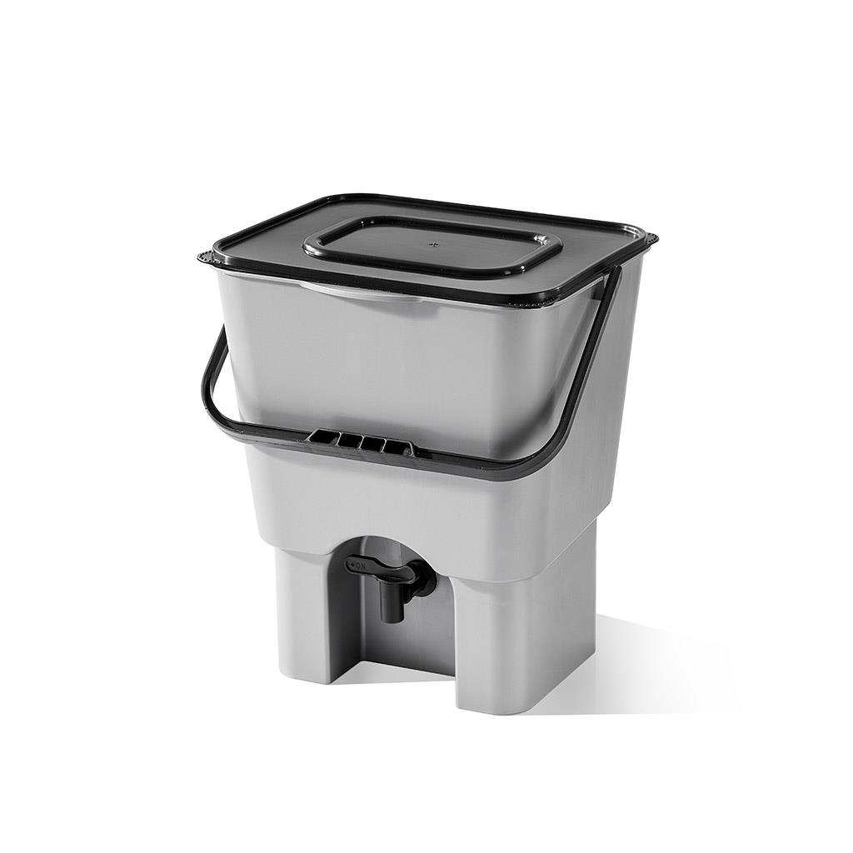
Composting food waste:
Bokashi
Anaerobic process - uses a bran containing microorganisms to ferment food waste
Tabletop bin - can be used indoors
Suitable for all kitchen waste: raw and cooked, meat, fish and dairy
Produces bokashi ‘tea’ - concentrated fertiliser
Solid waste needs to finish breaking down - in a pallet bay or buried in garden bed
Costs £25 + bran
Composting Workshop Slides 12 June 2023
Notes:
Bokashi bins cost about £25.
Food waste is fermented using a bokashi bran that contains microorganisms.
Bins are small so they are ideal for indoor use. Waste doesn’t fully decompose so it needs to be put in a compost bay or buried in the ground to ‘mature’ - or added to a wormery (do this gradually so the worms can get used to it).
It’s suitable for all kitchen waste, including cooked food, dairy and meat. It produces bokashi ‘tea’, a concentrated fertiliser

Slide 24
Frequently Asked Questions?
Composting Workshop Slides 12 June 2023

Slide 25
Will my compost smell bad?
Composting Workshop Slides 12 June 2023
Notes:
No, properly managed compost should not smell unpleasant.
It might smell if there is too much high nitrogen ‘green’ material as this can produce ammonia as it breaks down.
If there is two much water or not enough oxygen then the compost will become anaerobic and start to produce methane.
To fix:
Add more ‘brown’ material.
Turn or mix well.
Make holes with a stick to add air or use a compost aerator
Veg scraps can be kept in the freezer until added to the compost to avoid kitchen smells and fruit flies.

Slide 26
How can I prevent rats visiting or living in my compost?
Composting Workshop Slides 12 June 2023
Notes:
Rats may come for food or shelter (the latter, especially in winter). They can often chew their way through plastic and wooden bins, and even chicken wire!
The fix
Maintain the pile properly, including:
Turn the compost often - it disturbs the pile which makes it less appealing as a place to shelter or visit
Keep it moist enough - dry piles are appealing as a shelter
Location:
In the open - Away from a wall or fence as they prefer to run along these in order to remain undetected
Near human activity - near house or path. Somewhere where it will be walked past often and there is noise (/kick the bin!) they dont like to be disturbed
Place it on a hard standing
Contents of bin:
Dont compost meat fish dairy cooked food in bins in outdoor compost piles(use a wormery or bokashi) - although they may come anyway (looking for shelter and can be attracted to other foods) rats dont seem to like the fermented food produced via the bokashi method
Egg shells are thought to attract rats
When adding food to compost, bury it in other materials (leaves, soil, finished compost, shredded paper) to make it more difficult for the rats to smell it

Slide 27
How can I get rid of house flies around my compost pile?
Composting Workshop Slides 12 June 2023
Notes:
Most pests and houseflies appear in compost piles because they are filled with their natural food. Once they eat, they lay eggs in the same area, creating a much bigger problem!
The fix: If manure and rotting vegetables aren’t on top of the soil, the flies can’t get to them easily to eat them, so always bury them with carbonaceous materials topped with a layer of soil. Turn the pile regularly - this will get the bacterial activity going which will heat up the pile and make it difficult for flies and their eggs to survive. Do this once a day for a while if you have a big problem.

Slide 28
Can I compost ‘compostable’ or ‘biodegradable’ packaging, coffee cups or cutlery?
Composting Workshop Slides 12 June 2023
Notes:
No, it is not advised to compost these materials unless they are specifically labelled as ‘home compostable’
“Biodegradable” just means can be broken down into smaller pieces by microorganisms, but the material might not be organic and could contain plastic. The term is not currently regulated.
“Compostable” usually means the material is compostable in commercial composters. Home composting systems don’t usually get hot enough to fully breakdown this material.

Slide 29
Useful resources
Visit www.replenishoxfordshire.com for a comprehensive guide to home composting and other resources on home growing and cooking.
Oxfordshire County Council Food's not rubbish! booklet with practical tips on how to make food go further and how to compost or recycle what can’t be eaten.
Soil biology and composting resources - world-leading soil scientist Dr Elaine Ingham
Understanding the soil food web
Composting and compost tea
Sign up to the Replenish newsletter to receive month-by-month food growing tips and seasonal, sustainable and zero-waste recipes. https://linktr.ee/replenishoxon
Composting Workshop Slides 12 June 2023

